Slide 1
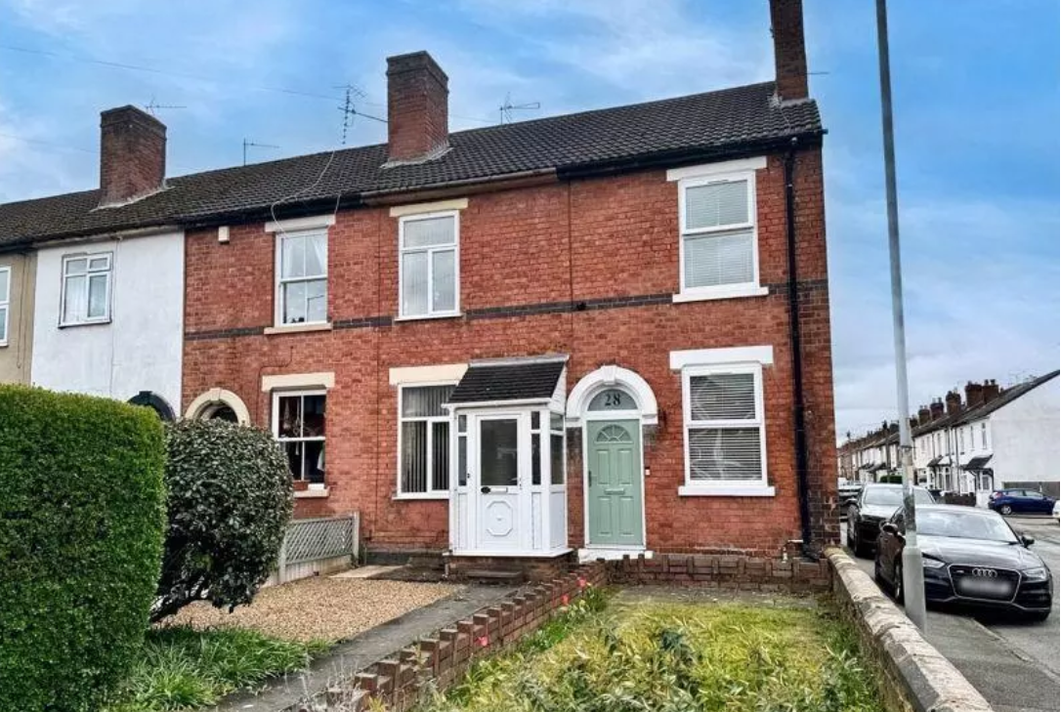
Private Sector Housing update
Topics covered:
Enforcement notices & Section 21 eviction
Damp & Mould winter update
Article 4 and HMO licensing
James Turner - Team Leader
james.turner@wolverhampton.gov.uk
Image taken from https://www.onthemarket.com/details/14635667/#/photos/1

Slide 2
Enforcement notices and Section 21 Eviction
What?
Deregulation Act 2015
Invalidates S.21
Why?
Retaliatory eviction
How?
Written complaint
‘Relevant Notice’
Section 21 eviction implications
Limitations (AST, S.21 timing, S.8, property sale, revocation, RSL, repossession)
Image taken from https://depositphotos.com/photos/eviction-notice.html

Slide 3
Damp and Mould Winter update
What's happened?
Background to spotlight on mould
Government guidance to landlords; expectations on ventilation, heating, insulation
Ventilation – fans to bathroom / kitchen & openable windows, continuous humidistat, roof, floor voids
Heating – Controllable, economic to run, covers the whole house tenants understand how to use.
Insulation – Loft space 270mm, flat roof insulation, wall insulation, cold spots
Image taken from https://titanrebuild.com/what-happens-during-mold-remediation/

Slide 4
Damp and Mould Winter update
What are Private Sector Housing doing?
Increasing requests for help
More severe cases and risk of death
Mould interventions
Equipment offer – early intervention
How to request a kit
Image taken from https://titanrebuild.com/what-happens-during-mold-remediation/

Slide 5
Article 4 & licensing
What is an HMO?
Background to planning requirements
What changed?
14/9/2017
Why?
Proliferation of HMOs in City
ASB
Crime
Highways
Refuse issues
Image taken from https://investmentproperty.co.uk/landlord-and-tenant-resources/houses-in-multiple-occupation-hmo-guide-for-landlords-property-investors/

Slide 6
Article 4 & licensing
What now?
Change of use to HMO = Planning Permission
HMO licensing
Suitability for use/occupation
Fit and proper person
Licence conditions – certificate of lawfulness
Further info - planning@wolverhampton.gov.uk
FREE pre-application advice
Image taken from https://investmentproperty.co.uk/landlord-and-tenant-resources/houses-in-multiple-occupation-hmo-guide-for-landlords-property-investors/

